Slide 1
Electric Resistance
Electric Resistance: The ability of a material to resist the flow of charge
  Units: Ohms (Ω)
  The amount of charge that flows through a circuit depends on two things:
    Voltage provided by source
    Electric resistance of the conductor

Slide 2
Bell Ringer
Why are light bulbs more likely to burn out when they are first turned on as opposed to burning out after being on for a long period of time?

Slide 3
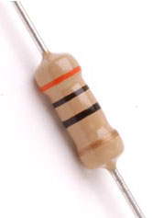
Resistors

Slide 4
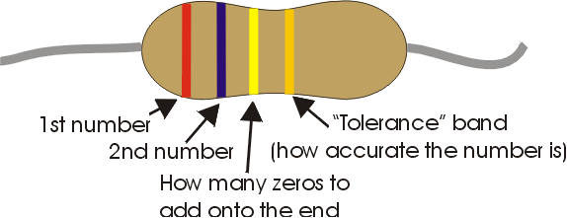
Bell Ringer
What is the resistance of this resistor?

Slide 5
Resistance in a Wire

Slide 6
Electric Resistance Factors
Thick wires have less resistance than thin wires
Short wires have less resistance than long wires
Higher temperatures usually cause more resistance
  The resistance in some materials becomes almost zero at very low temperatures

Slide 7
Ohm’s Law
The current in a circuit is
  Directly proportional to the voltage across the circuit
  Inversely proportional to the resistance of the circuit
  Therefore:
  Current = Voltage/Resistance
  or
  I = V/R

Slide 8
Ohm’s Law: Sample Problems
How much current flows in a 1000-ohm resistor when 1.5 volts are impressed across it?
How much resistance allows an impressed voltage of 6 V to produce a current of 0.006 A?
What voltage will produce 3 A through a 15-ohm resistor?

Slide 9
Voltage
Potential difference between two points
  Either side of a voltage source is not an eqipotential surface
  A wire is an equipotential surface
    It has the same potential
    If the wire is attached to a voltage source it is still an equipotential surface

Slide 10
Current’s Direction
Electrons Travel from – to +
Current is actually the opposite direction of the flow of electrons

Slide 11
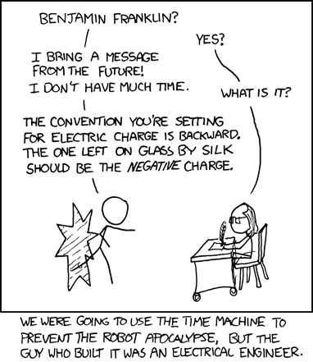

Slide 12
Ohm’s Law and Electric Shock
The current flowing through the human body depends on two factors:
  Voltage applied to the body
  Resistance of the body
The resistance of the human body could range from 100Ω (soaked in salt water) to 500,000Ω (very dry)
  The lower the resistance, the greater the shock

Slide 13
Ohm’s Law and Electric Shock
Current | Effect
0.001 A (1 mA) | Can be felt
0.005 A (5 mA) | Painful
0.010 A (10 mA) | Involuntary muscle contractions (spasms)
0.015 A (15 mA) | Loss of muscle control
0.070 A (70 mA) | If through the heart, serious disruption. More than 1 second, probably fatal

Slide 14
Bell Ringer
A CD player with a resistance of 40 ohms has a current of 0.1 amps flowing through it. How many volts are supplied to the CD player?

Slide 15
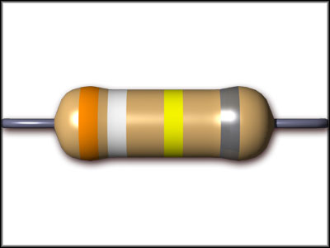
Review
What is the resistance of this resistor?

Slide 16
Electric Power
The rate at which electrical energy is converted to other forms
  Electric Power = Current ^{x} Voltage
  P = IV
  Units: Watts (W)
    1 kilowatt (kW) = 1000 W

Slide 17
Electric Power
Kilowatt-Hour (kWh): The amount of energy consumed in 1 hour at a rate of 1 kW
  Example: In a place where energy is 5¢ per kWh, a 100 W light bulb can be lit for 10 hours for 5¢

Slide 18
Electric Power
What is the power when a voltage of 120 V drives a 2-A current through a device?
How much current does a100-W lamp draw when connected to 120 V?

Slide 19
Electrical Tools
Voltmeter
  Measures potential difference
Ammeter
  Measures the flow of charge
Ohmmeter
  Measures the resistance to the flow of charge

Slide 20
Phet Circuit Construction Ohm’s Law Practice

Slide 21
Bell Ringer
Complete the Big Ideas Table

Slide 22
Bell Ringer
What is the resistance of a 100W lightbulb as it is attached to a 120V outlet?

Slide 23
AC and DC
Direct Current (DC)
  Flow of charge in one direction
  Example: The terminals of a battery do not switch signs
    Therefore electrons are always repelled away from the (-) terminal and toward the (+)

Slide 24
AC and DC
Alternating (AC)
  Charges in the circuit first move in one direction, then in the other
  Accomplished by alternating the polarity of the voltage source

Slide 25
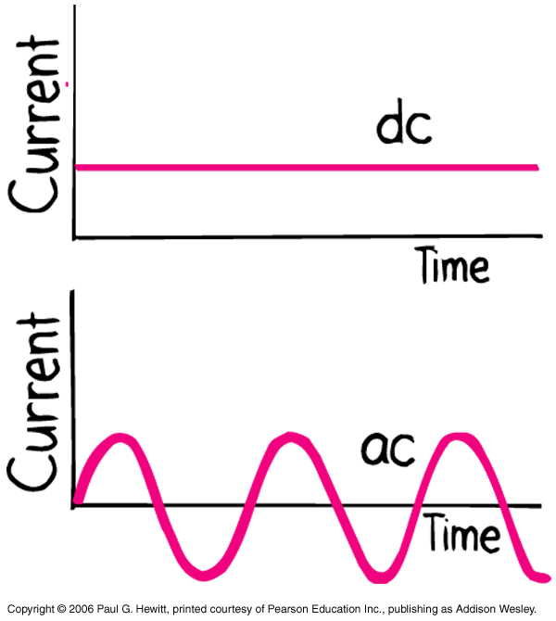
AC and DC

Slide 26
Converting AC to DC
Wall outlets: AC
Battery operated devices: DC
AC adaptors have three main components
  Transformer: Lowers voltage
  Diode: Acts as a one-way valve to allow electron flow in only one direction
    AC acts in 2 directions; the diode only allows half of each cycle through

Slide 27
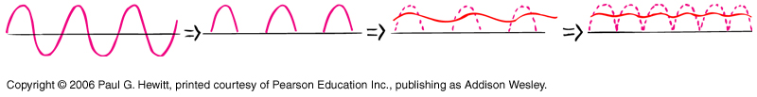
Converting AC to DC
  Capacitor: Stores charge to smooth the signal between each half cycle
    An additional diode can also be used

Slide 28
Bell Ringer
What three electrical devices are used to convert alternating current to direct current?
How much current passes through a device of 15kΩ when attached to a 9V source?

Slide 29
The Speed of Electrons in a Circuit
At room temperature, electrons in a wire have speeds up to a few million km/hr
  This motion does not produce an organized current
When a voltage source is connected, an electric field is established through the wire

Slide 30
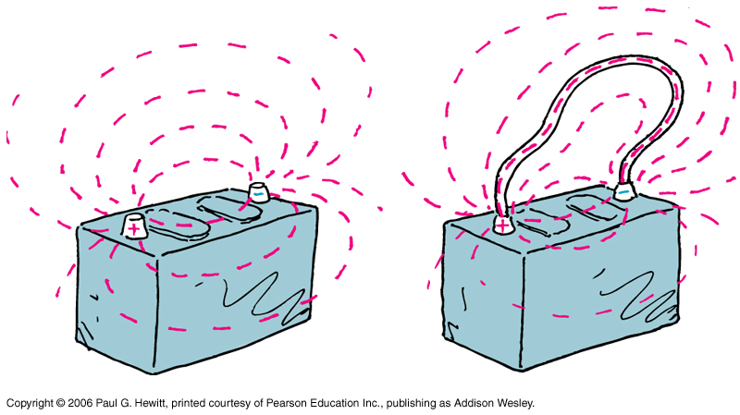
The Speed of Electrons in a Circuit

Slide 31
The Speed of Electrons in a Circuit
The electric field directs the electrons along, producing a current
  Electrons collide with each other along the way

Slide 32
The Speed of Electrons in a Circuit
The electric field pulses through the wire at nearly the speed of light, however:
  In DC circuits, the electrons have a drift speed of about 0.01 cm/s
  In AC circuits, the electrons vibrate back and forth, so drift speeds are nearly zero

